Slide 1
EMBODIED AI · WEEK 26
Every format, and every posture
Last week the R1 could read two of the eight motion formats the tool supports, and every result
I had came from the same boxing clip — the only motion file it ships. This week I worked out the
rule for writing the missing configs, wrote all six, and used one of them to reach a dataset of
77 human captures. The robot now does thirteen kinds of motion. Four of them it could not do.
Shaoqin Li · Prof. Yi Sun · CCNY

Slide 2
Where week 25 left it
Two things were true at the end of the last talk, and both were limits.
The R1 could read 2 formats of 8
Every result came from one clip
The tool keeps one mapping file per
(motion format, robot) pair. I had written two
for the R1 — Xsens BVH, which I tested, and
SMPL-X, which I never did.
The other six had no R1 entry at all, so the
robot could not even be selected.
The tool ships exactly one motion file: a
35-second Xsens boxing capture.
That is the only reason every video, every
measurement and every slide I have shown
so far is boxing. It was never a choice about
what to study.
So the honest description of the result was: one robot, one format, one posture
Both limits have the same shape — a missing file. Neither needed new research to fix, and until
they were fixed I could not say anything about how retargeting behaves across different motions.
This week is those two files, and what they let me measure.

Slide 3
PART ONE
The six missing configs
Reverse-engineering the rule from the two that already worked
The point is not the JSON. It is that the rule was checkable, and the check failed the first time.

Slide 4
What one of these files actually is
A mapping file has two jobs, and both of them are robot-specific.
1 · How big is the human?
2 · Which robot part tracks which body part?
A table of 14 numbers that shrinks a human skeleton onto the robot's
proportions — two for the torso, six for the legs, six for the arms.
The R1 is smaller than the G1, so every one of these differs.
Fourteen entries naming a link on the robot and the human joint it should
follow, with weights and an offset.
The R1 does not have all the links the G1 has, so some of these names
point at nothing.
eight for the G1, two for the R1
$ ls general_motion_retargeting/ik_configs/ | grep _to_g1
bvh_lafan1_to_g1.json fbx_offline_to_g1.json xrobot_to_g1.json
bvh_nokov_to_g1.json fbx_to_g1.json xsens_mvn_to_g1.json
bvh_xsens_to_g1.json smplx_to_g1.json
$ ls general_motion_retargeting/ik_configs/ | grep _to_r1
bvh_xsens_to_r1.json smplx_to_r1.json

Slide 5
The rule was already in the two files I had
I did not invent a mapping. I measured what the two working configs did to their G1 parents.
R1 is the G1 config times a fixed per-limb ratio
human_scale_table bvh_xsens_to_g1 -> bvh_xsens_to_r1 ratio
Hips 0.9 0.84 0.9333
Chest4 0.9 0.84 0.9333
LeftHip / RightHip 0.9 0.818 0.9089
LeftKnee / RightKnee 0.9 0.818 0.9089
LeftShoulder / Right 0.75 0.578 0.7707
LeftElbow / RightElbow 0.75 0.578 0.7707
The proof it is a ratio and not a fixed number
SMPL-X uses 0.617 for the arms, not 0.578. For a while that looked like an inconsistency. It is not:
the G1's SMPL-X baseline is 0.8 rather than 0.75, and 0.8 × 0.7707 = 0.617. The format sets the
baseline, the robot sets the ratio. One rule reproduces both files.
torso × 0.9333 legs × 0.9089 arms × 0.7707

Slide 6
I wrote the rule as a script, and made it check itself first
Before generating anything, regenerate the two configs that already exist and compare. It failed.
first run
$ python make_r1_configs.py --check
Regenerating the two R1 configs that already existed, from their G1 parents.
Both must come out identical to the files on disk for the rule to hold.
bvh_xsens_to_r1.json MATCH
smplx_to_r1.json DIFFERS
first difference in: ik_match_table1
RULE FAILED.
What it caught
Renaming the G1's toe link to the R1's ankle link is not enough. The G1 config also carries a small
position offset — [0, ±0.02, 0] for SMPL-X, [0.05, 0, 0] for XRobot — and that offset is measured in
the toe body's own frame. The R1 has no toe, so the offset is being applied relative to a completely
different part of the leg. Whoever wrote smplx_to_r1 by hand had zeroed it. The rename has to drop
the offset too. Wrist offsets are zero in every file, which is why the Xsens config passed and hid it.

Slide 7
With that fixed, the rule reproduces both files exactly
Then, and only then, generate the six that were missing.
$ python make_r1_configs.py --check
bvh_xsens_to_r1.json MATCH
smplx_to_r1.json MATCH
Rule reproduces both existing configs.
$ python make_r1_configs.py
R1 model has 26 bodies. Generating 6 config(s).
bvh_lafan1 -> bvh_lafan1_to_r1.json scales 0.84/0.818/0.578 ok
bvh_nokov -> bvh_nokov_to_r1.json scales 0.84/0.818/0.578 ok
xsens_mvn -> xsens_mvn_to_r1.json scales 0.747/0.727/0.578 ok
fbx -> fbx_to_r1.json scales 0.84/0.818/0.617 ok
fbx_offline -> fbx_offline_to_r1.json scales 0.84/0.818/0.617 ok
xrobot -> xrobot_to_r1.json scales 0.84/0.818/0.617 ok
Every robot link resolves against r1_mocap.xml.
The scales differ per format because the baselines do. That is the ratio rule working, not a bug.

Slide 8
The R1 now reads every format the tool supports
Checked by loading the registry, not by looking at the folder.
format G1 R1 config file
bvh_lafan1 yes yes bvh_lafan1_to_r1.json
bvh_nokov yes yes bvh_nokov_to_r1.json
bvh_xsens yes yes bvh_xsens_to_r1.json
fbx yes yes fbx_to_r1.json
fbx_offline yes yes fbx_offline_to_r1.json
smplx yes yes smplx_to_r1.json
xrobot yes yes xrobot_to_r1.json
xsens_mvn yes yes xsens_mvn_to_r1.json
R1 supports 8 of 8 input formats
What this buys
Every public motion dataset
that exports one of these
formats is now reachable
by our robot.
That includes LAFAN1 — the
benchmark the retargeting
paper itself uses, and which
I could not run last week.
Said honestly
Six of these are generated and structurally verified — every robot link resolves against the R1 model.
That is not the same as tested on real motion. Two of them now are: LAFAN1 and SMPL-X. The other
four need capture hardware or vendor data I do not have.

Slide 9
PART TWO
Thirteen postures
What the robot does when it stops boxing
77 human captures, 15 categories. The first time this project has looked at more than one motion.

Slide 10
LAFAN1
The dataset the retargeting paper benchmarks on, and the one I could not open last week.
What it is
Why it was unreachable
What it contains
Ubisoft motion capture,
public on GitHub, no
registration.
77 sequences, about
4.6 hours, 144 MB.
One missing file:
bvh_lafan1_to_r1.json.
The dataset was always
free. The robot just had
no mapping for it.
walk, run, sprint, dance,
fight, jumps, ground,
fallAndGetUp, obstacles,
aiming, push, and more.
15 categories.
A correction I had to make to my own assumption
I had recorded that LAFAN1 was the gated dataset and AMASS was the open one. It is the other way
round. LAFAN1 needs no registration at all — it is a zip file in a public repository. I checked before
building on it, and the check is the only reason this week happened at all.

Slide 11
First: is there a trap at the start of these files?
The Xsens capture opens with a stationary calibration T-pose. Measuring it produces confident nonsense.
$ python week26_posture_sweep.py --probe
PROBE -- frames 0:150 of each clip, looking for a static opening pose
category pelvis cm peak rad/s verdict
walk 3.55 10.7 already moving
run 2.49 4.2 already moving
dance 4.24 5.2 already moving
fight 12.20 9.0 already moving
ground 3.19 4.7 already moving
fallAndGetUp 10.27 12.7 already moving
obstacles 7.02 7.8 already moving
multipleActions 44.65 7.8 already moving
No trap here
All thirteen categories are
moving from frame zero.
LAFAN1 does not carry the
calibration pose that cost
me an hour on the Xsens
capture.
Worth one command rather
than assuming.
The habit is the point: the same check that caught the T-pose is now run before trusting any new dataset.

Slide 12
One clip from every category, 20 seconds each, onto the R1
Same four plausibility checks as experiment 4, so the numbers compare across postures.
category IK fps lowest contact pelvis limits peak
-------------------------------------------------------------------
walk 166.4 +0.82cm 2.3% 4.82cm 0 10.2
run 156.1 +1.25cm 0.0% 12.41cm 0 9.6
sprint 135.8 -2.13cm 2.8% 23.60cm 0 19.6
dance 129.1 -0.17cm 5.2% 22.11cm 0 18.0
fight 122.3 -2.22cm 7.8% 38.01cm 0 32.9
fightAndSports 118.0 -1.03cm 21.0% 30.34cm 0 29.5
jumps 210.1 -9.90cm 6.0% 29.88cm 0 17.7
ground 172.9 -45.63cm 1.8% 68.58cm 0 28.7
fallAndGetUp 125.5 -42.88cm 5.3% 77.09cm 0 32.1
obstacles 128.2 +0.71cm 0.5% 94.43cm 0 11.5
aiming 135.2 +0.93cm 0.7% 3.99cm 0 6.7
push 179.2 +1.62cm 0.0% 7.85cm 0 15.6
multipleActions 117.7 -13.07cm 13.3% 72.14cm 0 12.5
Every one of these runs faster than the motion plays. Nothing here needs a GPU.

Slide 13
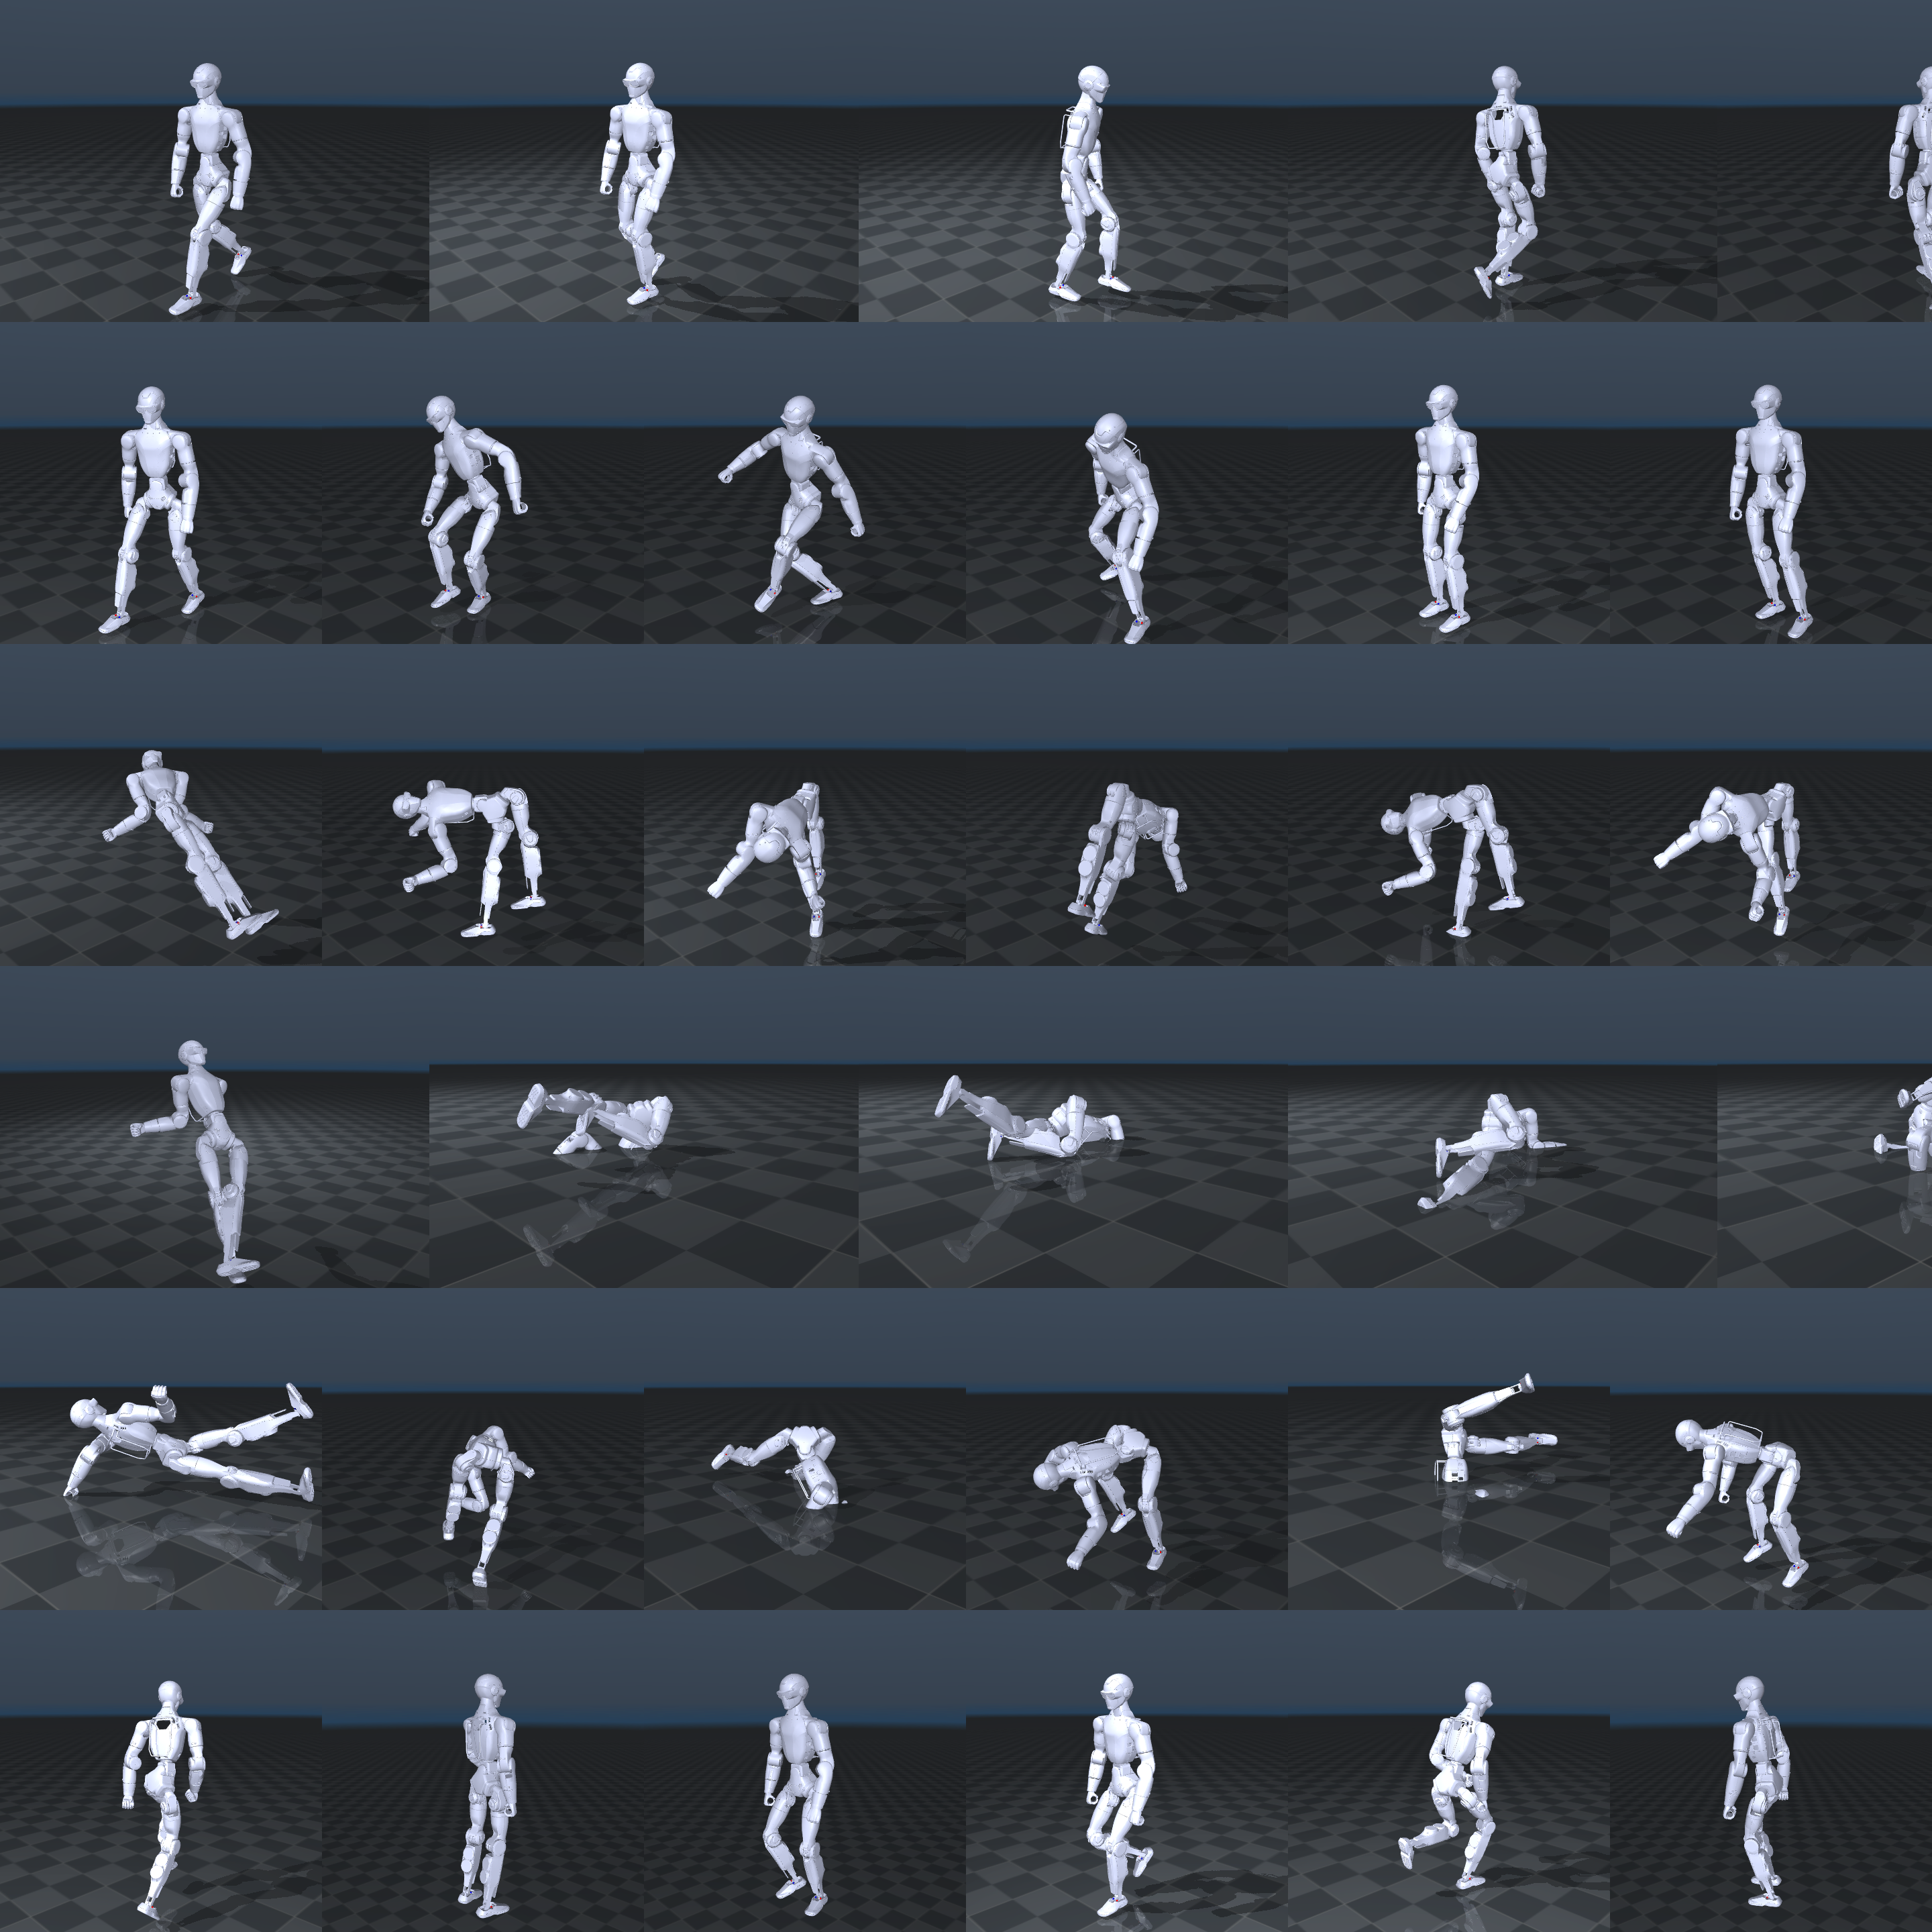
What that looks like
Six frames from each of six categories, same robot, same camera.
walk dance jumps ground fallAndGetUp obstacles

Slide 14
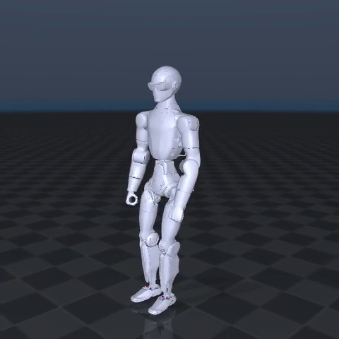
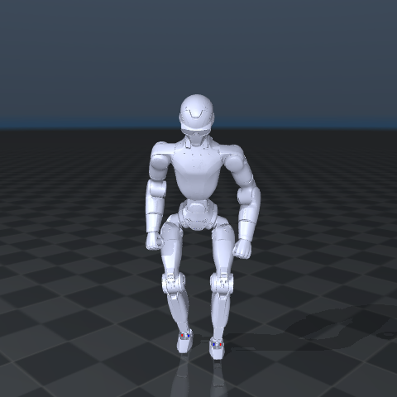
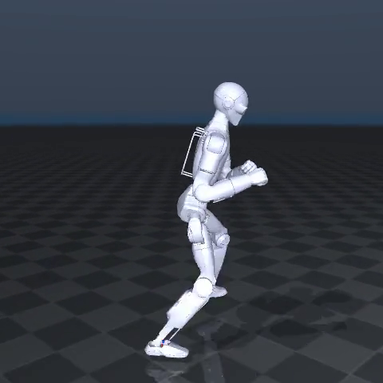
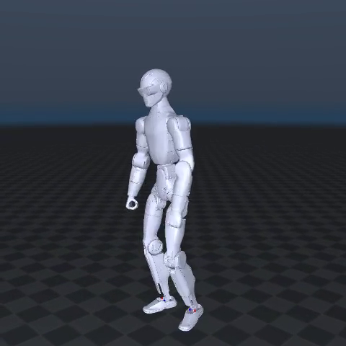
Thirteen kinds of motion — here are four of them moving
Same robot, same config, same 20-second window. The only thing that changed is the input clip.
dance — 18.0 rad/s, inside budget
jumps — airborne, both feet leave the floor
fight — 32.9 rad/s, over budget
obstacles — 0.5% contact, steps over
Two of these are inside every budget I measured. Two are not — and nothing in the video tells you which is which.
That is what the next five slides are for.

Slide 15
Finding 1 — not one joint limit violated, in any posture
7,800 frames across thirteen categories, including combat and floor work.
What I measured
Why it is worth saying
Zero frames out of 7,800 push any of the 24 joints past its
mechanical stop. That holds for fight, for jumps, for
crawling on the floor — the motions most likely to break it.
I then ran the identical clips on the G1. Also zero.
15,600 frames, two robots, not one violation.
A recent paper reports that this same tool violates joint
limits on 43.21% of 49,672 frames.
I cannot reproduce anything like that on either robot — and
the G1 is the robot that tool was built around, so 'different
robot' no longer explains the gap.
The honest reading
Still not a refutation — different clips, and possibly an older version of the tool. But the one
explanation I could have offered last week, that the R1 is simply not the robot they measured, is
now ruled out by my own control.

Slide 16
Finding 2 — the floating problem depends entirely on the motion
Boxing never touched the floor. That turned out to be a fact about boxing.
lowest point of the robot, and how often it reaches the floor
boxing, all 4249 frames +3.22 .. +5.57 cm 0 / 4249 contact (0%)
walk +0.82 cm 14 / 600 contact (2.3%)
aiming +0.93 cm 4 / 600 contact (0.7%)
obstacles +0.71 cm 3 / 600 contact (0.5%)
fightAndSports -1.03 cm 126 / 600 contact (21.0%)
run +1.25 cm 0 / 600 contact (0.0%)
What changed in my understanding
I had been treating 'the retargeted motion floats' as a property of kinematic retargeting. It is not.
It is a property of a clip where the human keeps both feet planted and the scale mismatch has
nowhere to go. Give it walking and the feet land. Give it running and they leave the ground for real
reasons. The artifact and the correct behaviour look identical in a single number.

Slide 17
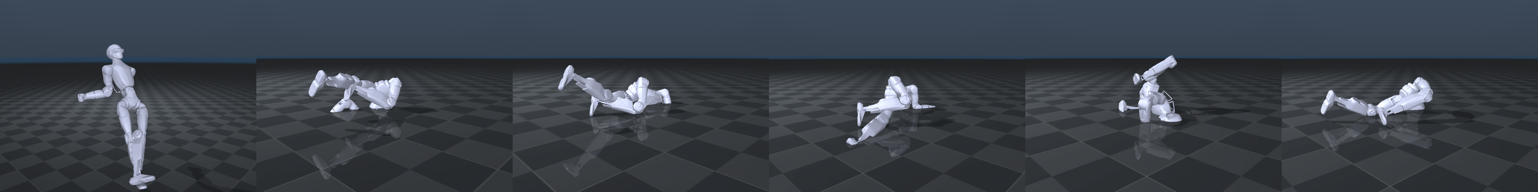
Finding 3 — lying down puts the robot through the floor
ground: -45.63 cm. fallAndGetUp: -42.88 cm. Verified by looking — and the G1 sinks just as far.
Why it happens
Why it matters to us
Kinematic retargeting solves for joint angles that put the
robot's links where the human's joints were. Nothing in it
knows the floor exists. While the human is upright the feet
hide it; once the torso is what touches the ground, there is
no constraint left to stop it sinking.
Not an R1 defect: mean lowest point across all thirteen is
-8.59 cm on the R1 and -8.49 cm on the G1.
This is exactly the gap the KDMR paper closes, by solving
for contact forces and forbidding a foot from pulling on
the ground.
It needs force plates. Detecting contact from kinematics
alone is named as future work — and that is the opening
I have been describing for three weeks.

Slide 18
Finding 4 — four categories need impossible motor speeds
Peak joint speed against a deliberately generous 20 rad/s budget.
fight 32.9 rad/s exceeded
fallAndGetUp 32.1 rad/s exceeded
fightAndSports 29.5 rad/s exceeded
ground 28.7 rad/s exceeded
------------------------------------------
sprint 19.6 rad/s within budget
dance 18.0 rad/s within budget
walk 10.2 rad/s within budget
aiming 6.7 rad/s within budget
The pattern
The four that fail are the
four with fast contact
transitions — striking,
falling, pushing off the
floor.
Locomotion and aiming
are comfortably inside
budget.
So the limit is not the
robot's size. It is what
the motion asks of it.
None of this is visible in the video
All thirteen look convincing when played back. Four of them describe a machine that cannot exist.
And the G1 exceeds on the same four — worse on fallAndGetUp, 51.4 rad/s — so this is what the
motion demands, not a limit of the R1's size.

Slide 19
Finding 5 — the one thing that is actually about the R1
Everything above turned out to be the method. This did not.
dataset / format R1 G1
------------------------------------------
LAFAN1, 13 categories 5.1% 10.6%
OMOMO clip, SMPL-X 78% 99%
------------------------------------------
deepest penetration -2.33 cm -1.04 cm
(on the OMOMO clip)
The R1 reaches the floor about half as often.
Two datasets, one direction
Different capture system,
different skeleton, different
kind of motion — and the
same deficit both times.
So it is not something
about LAFAN1. It is
something about our R1
setup.
What it probably is
The R1 touches the floor LESS often than the G1, yet sinks DEEPER when it does. Feet that were
simply too high would do both less — both at once means the foot target lands with more spread,
which is what a leg-length mismatch looks like. The config scales the legs by 0.818, but the R1's
measured ratios are 0.673 at the thigh and 0.735 at the shank, and 0.818 was tuned, not derived.

Slide 20
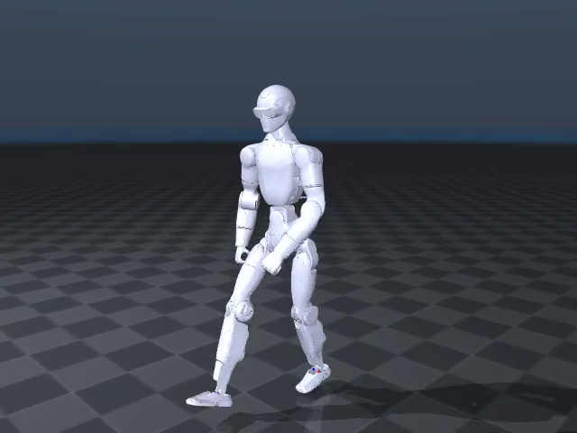
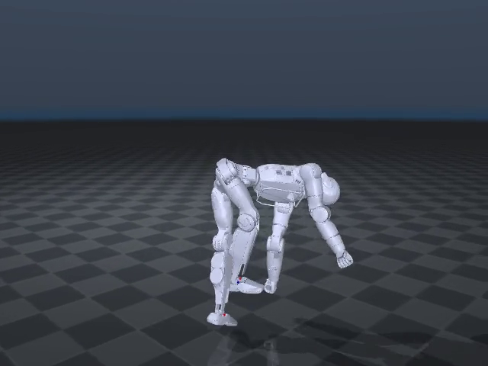
The clean case and the broken one
Same robot, same pipeline, same 20-second window. Left walks. Right is supposed to be on the floor.
walk — feet land, 2.3% contact
ground — 45 cm through the floor

Slide 21
What is true now that was not last week
Five things, and one of them is a limitation.
The R1 reads all 8 motion formats
Six configs generated from a rule that reproduces the two hand-written ones exactly.
The R1 does 13 kinds of motion, not 1
LAFAN1 is reachable. 77 captures instead of the single boxing clip the tool ships.
Plausibility varies enormously by posture
Zero joint violations; contact 0% to 21%; four categories over servo speed; two through the floor.
The numbers now have a baseline
Every clip re-run on the G1. Joint limits, floor penetration and servo speed match on both robots.
Four of the six new configs are untested
Structurally verified — every link resolves — but they need capture hardware or vendor data I do
not have. Generated is not the same as working, and I am not going to claim otherwise.

Slide 22
What I would do next
In the order I think they are worth doing.
Run GMR's own benchmark on the R1
1
LAFAN1 is the dataset the retargeting paper evaluates on. Until this week the R1 could not be
part of that comparison. Now it can, and their published numbers are the baseline.
Explain the contact gap
2
The R1 touches the floor about half as often as the G1, on both datasets. It also penetrates
deeper when it does — which is what a leg-length mismatch looks like. Sweep the leg scale.
A kinematics-only contact check
3
The floor penetration is measurable without force plates. Detecting contact from kinematics is
the gap KDMR names as future work, and it is the right size for this project.
Push breadth from 13 clips to all 77
4
Everything above samples one clip per category. The full set would show whether these numbers
hold within a category or just for the clip I happened to pick.

Slide 23
Two missing files
Neither of the limits I described last week needed new research. One was a mapping file the tool
did not ship for our robot; the other was a dataset I had wrongly recorded as gated. Writing the
first and checking the second took the project from one posture to thirteen — and only then did
the interesting failures show up, because they are failures you cannot see in a single clip.
Shaoqin Li · Embodied AI · Week 26

